Slide 1
E-Commerce and Technologies
Online Security and Payment Systems

Slide 2
Objectives
Explain the scope of e-commerce crime and security problems.
Describe the key dimensions of e-commerce security.
Identify the key security threats in the e-commerce environment.
Describe the features of traditional payment systems.
Explain the major e-commerce payment mechanisms.

Slide 3
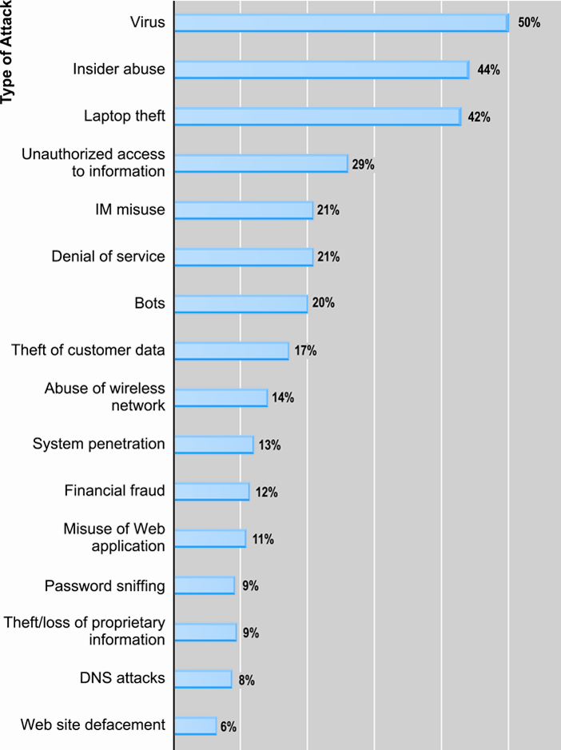
Types of Attacks Against Computer Systems (Cybercrime)
Figure 5.1, Page 267
Source: Based on data from Computer Security Institute, 2009.

Slide 4
What Is Good E-commerce Security?
To achieve highest degree of security
New technologies
Organizational policies and procedures
Industry standards and government laws
Other factors
Time value of money
Cost of security vs. potential loss
Security often breaks at weakest link

Slide 5
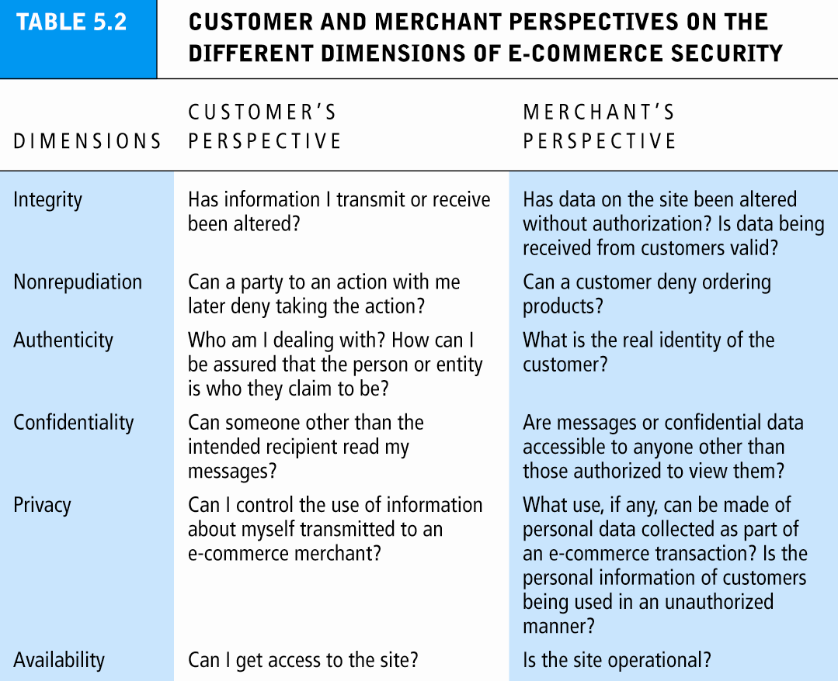
Table 5.2, Page 271

Slide 6
Security Threats in the E-commerce Environment
Three key points of vulnerability:
Client
Server
Communications pipeline

Slide 7
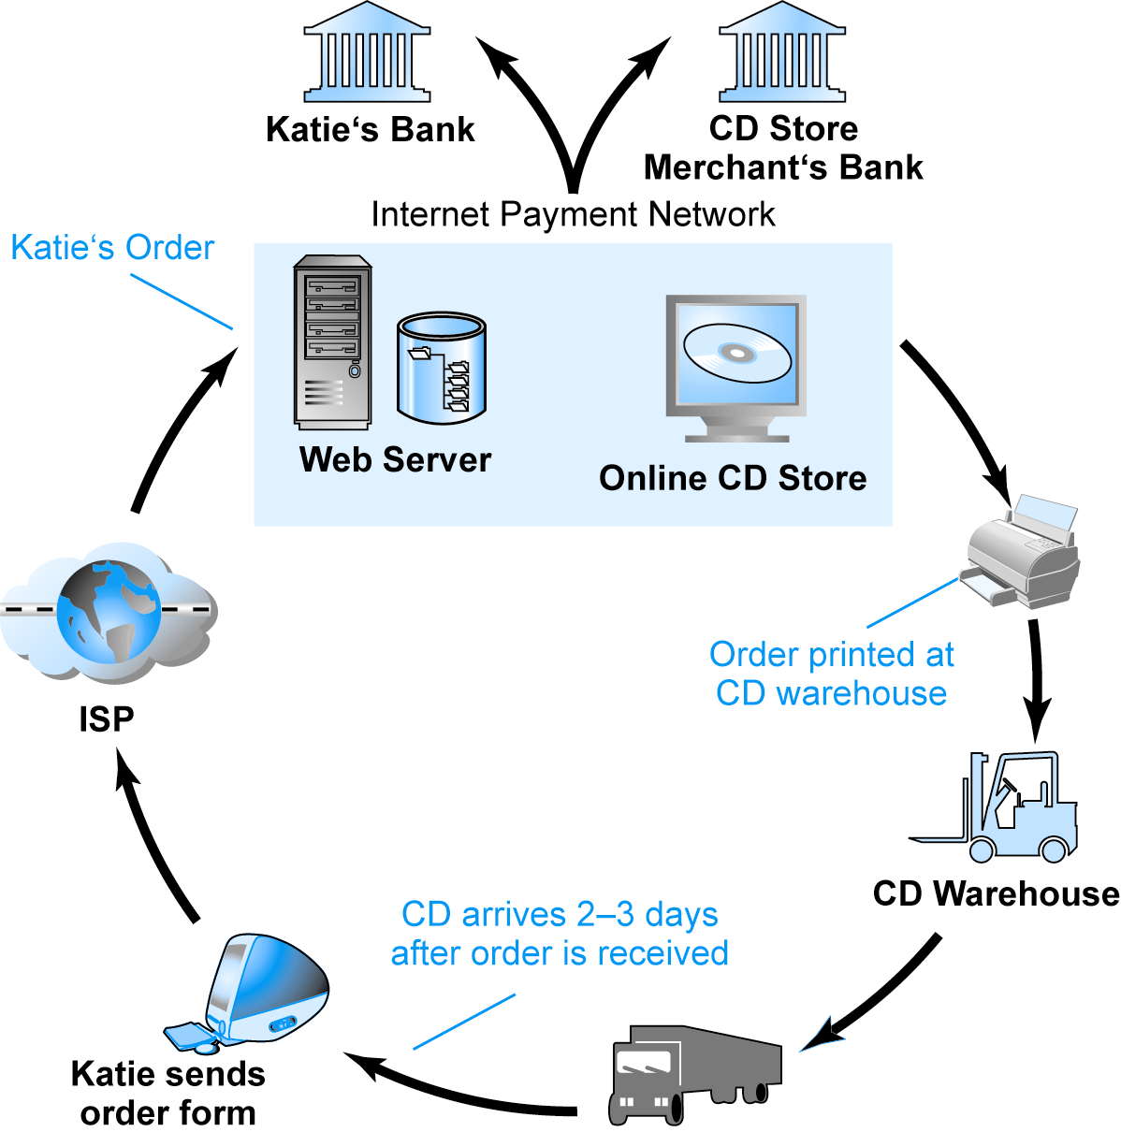
A Typical E-commerce Transaction
SOURCE: Boncella, 2000.
Figure 5.3, Page 273

Slide 8
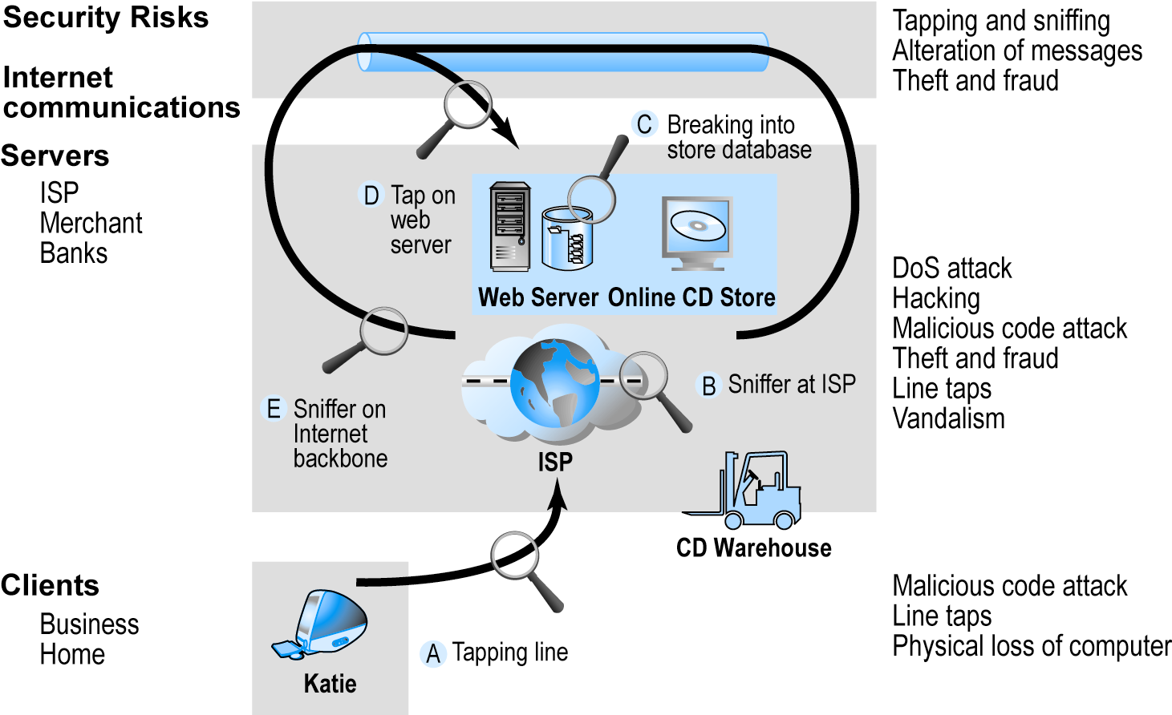
Vulnerable Points in an E-commerce Environment
SOURCE: Boncella, 2000.
Figure 5.4, Page 274

Slide 9
Most Common Security Threats in the E-commerce Environment
Malicious code
Viruses
Worms
Trojan horses
Bots, botnets
Unwanted programs
Browser parasites
Adware
Spyware

Slide 10
Most Common Security Threats
Phishing
Deceptive online attempt to obtain confidential information
Social engineering, e-mail scams, spoofing legitimate Web sites
Use information to commit fraudulent acts (access checking accounts), steal identity
Hacking and cybervandalism
Hackers vs. crackers
Cybervandalism: intentionally disrupting, defacing, destroying Web site
Types of hackers: white hats, black hats, grey hats

Slide 11
Most Common Security Threats
Credit card fraud/theft
Fear of stolen credit card information deters online purchases
Hackers target merchant servers; use data to establish credit under false identity
Online companies at higher risk than offline
Spoofing: misrepresenting self by using fake e-mail address
Pharming: spoofing a Web site
Redirecting a Web link to a new, fake Web site
Spam/junk Web sites
Splogs

Slide 12
Most Common Security Threats
Denial of service (DoS) attack
Hackers flood site with useless traffic to overwhelm network
Distributed denial of service (DDoS) attack
Hackers use multiple computers to attack target network
Sniffing
Eavesdropping program that monitors information traveling over a network
Insider jobs
Single largest financial threat
Poorly designed server and client software

Slide 13
Technology Solutions
Protecting Internet communications (encryption)
Securing channels of communication (SSL, S-HTTP, VPNs)
Protecting networks (firewalls)
Protecting servers and clients

Slide 14
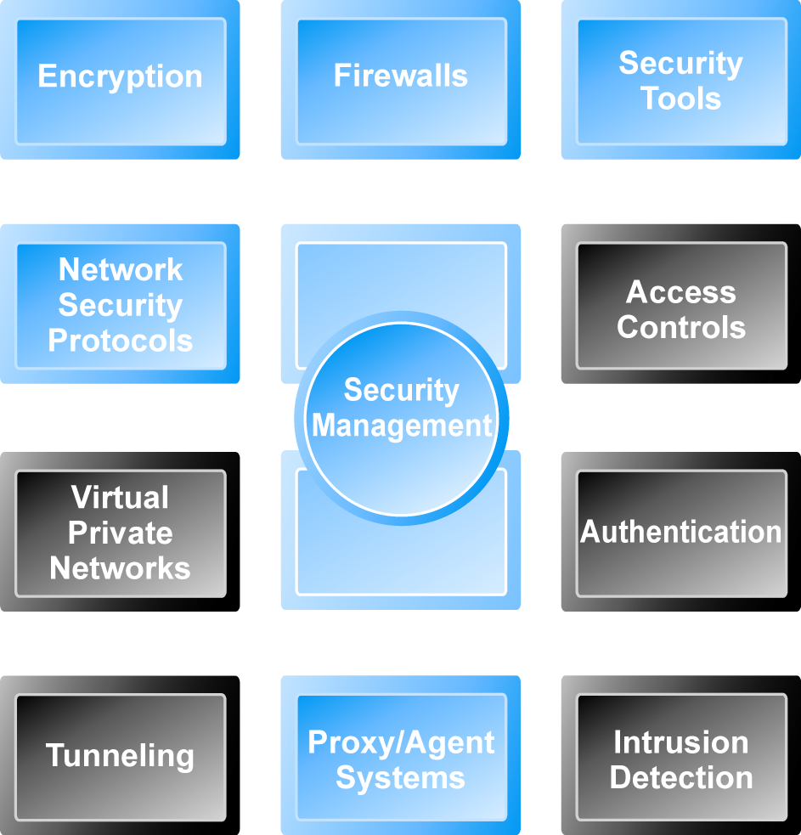
Tools Available to Achieve Site Security
Figure 5.7, Page 287

Slide 15
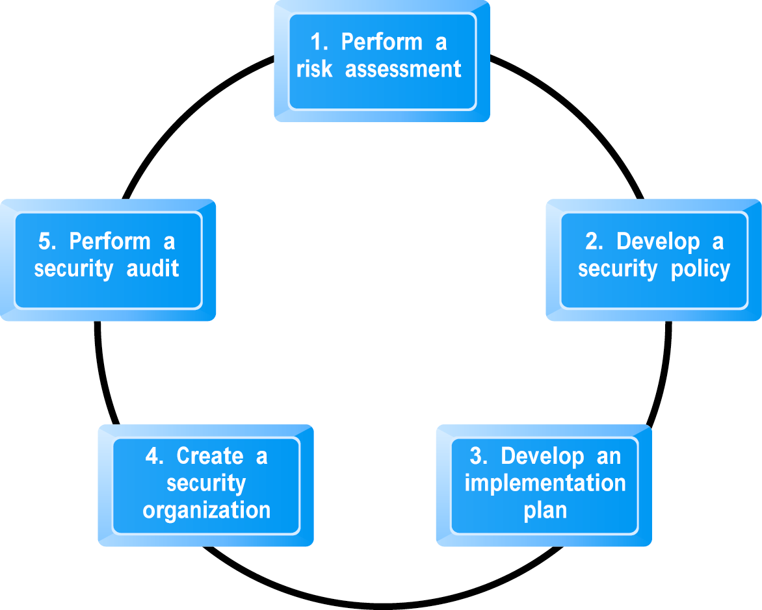
Developing an E-commerce Security Plan
Figure 5.14, Page 303

Slide 16
Types of Payment Systems
Cash
Most common form of payment in terms of number of transactions
Instantly convertible into other forms of value without intermediation
Checking transfer
Second most common payment form in the United States in terms of number of transactions
Credit card
Credit card associations
Issuing banks
Processing centers

Slide 17
Types of Payment Systems
Stored Value
Funds deposited into account, from which funds are paid out or withdrawn as needed, e.g., debit cards, gift certificates
Peer-to-peer payment systems
Accumulating Balance
Accounts that accumulate expenditures and to which consumers make period payments
E.g., utility, phone, American Express accounts

Slide 18
E-commerce Payment Systems
Digital wallets
Emulates functionality of wallet by authenticating consumer, storing and transferring value, and securing payment process from consumer to merchant
Early efforts to popularize failed
Newest effort: Google Checkout
Digital cash
Value storage and exchange using tokens
Most early examples have disappeared; protocols and practices too complex

Slide 19
E-commerce Payment Systems
Online stored value systems
Based on value stored in a consumer’s bank, checking, or credit card account
PayPal, smart cards
Digital accumulated balance payment
Users accumulate a debit balance for which they are billed at the end of the month
Digital checking:
Extends functionality of existing checking accounts for use online

